Slide 1
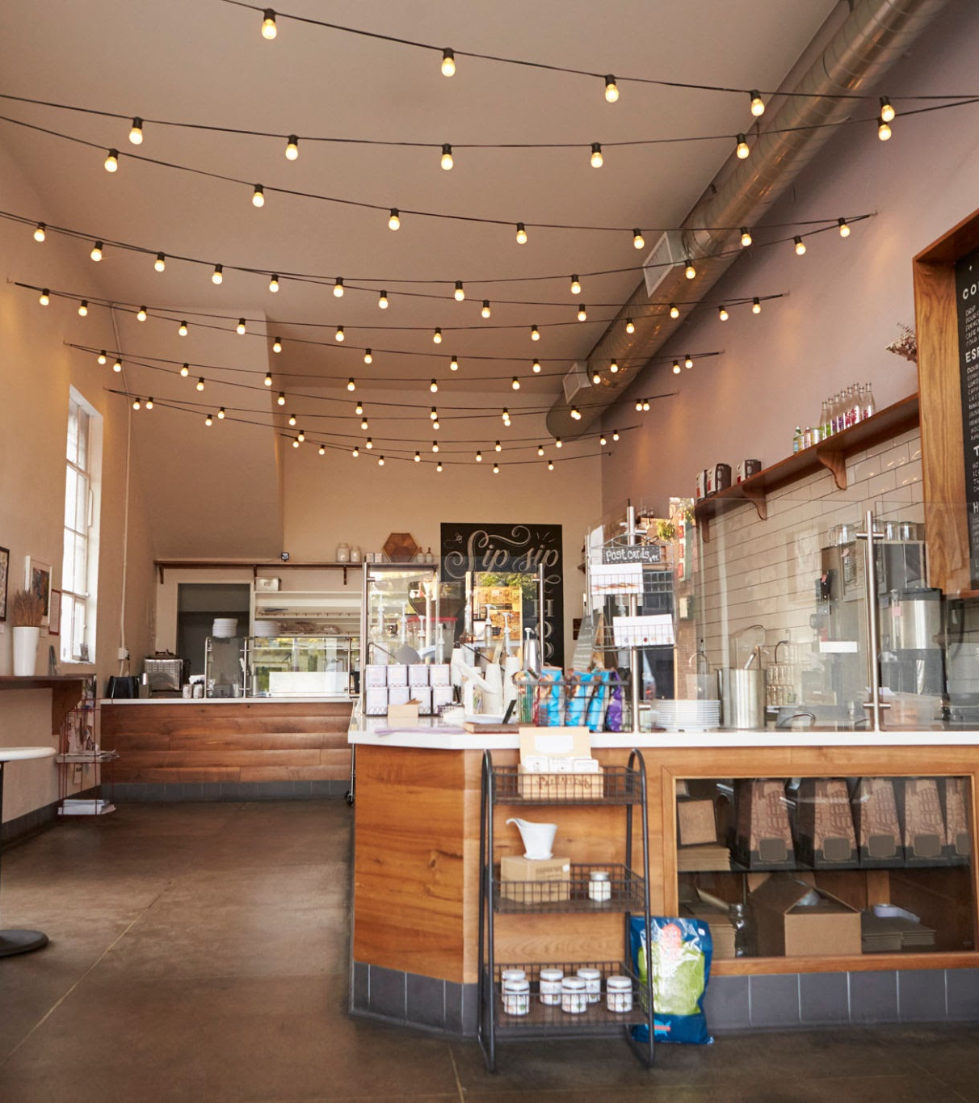
The Loneliness
Epidemic
Econ Hack 2026
By: The Missing Third
By: Yelizaveta Nazarova, Karolina Szczepanik, Jude Yurcich, and Madeline Steyee.

Slide 2

Third Spaces
Background
- Accessable
- Available
- Affordable

Slide 3
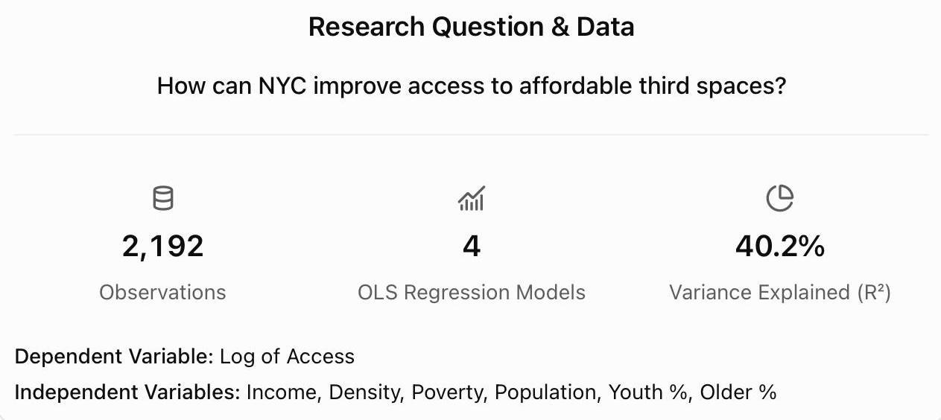
Our Dataset
Research Question
2,192 observations
Dependent Variable: Log of Access
Independent Variables: Income, Density, Poverty, Population, Youth %, Older %
How can NYC improve access to affordable third spaces across neighborhoods?
Our Approach
Econometric Analysis + Policy Design
The Missing Third

Slide 4
Three Barriers to Social Accessibility
The Missing Third
1. Physical Accessibility
Not every neighborhood has convenient access to third spaces.
2. Underutilized Infrastructure
Vacant commercial properties represent potential community-space opportunities.
3. Financial Accessibility
The cost of social activities may discourage participation.

Slide 5
Econometric Methodology
Company Name
OBJECTIVES
Model 1: Income Only
Model 2: Income + Density
Model 3: Full Socioeconomic Model
Model 4: Interaction Model
log(Access) = B0 + B1*log(Income) + e
log(Access) = B0 + B1log(Income) + B2log(Density) + e
log(Access) = B0 + B1log(Income) + B2log(Density) + B3Poverty + B4Youth + B5Older + B6Population + e
Model 3 + Income × Density Interaction

Slide 6
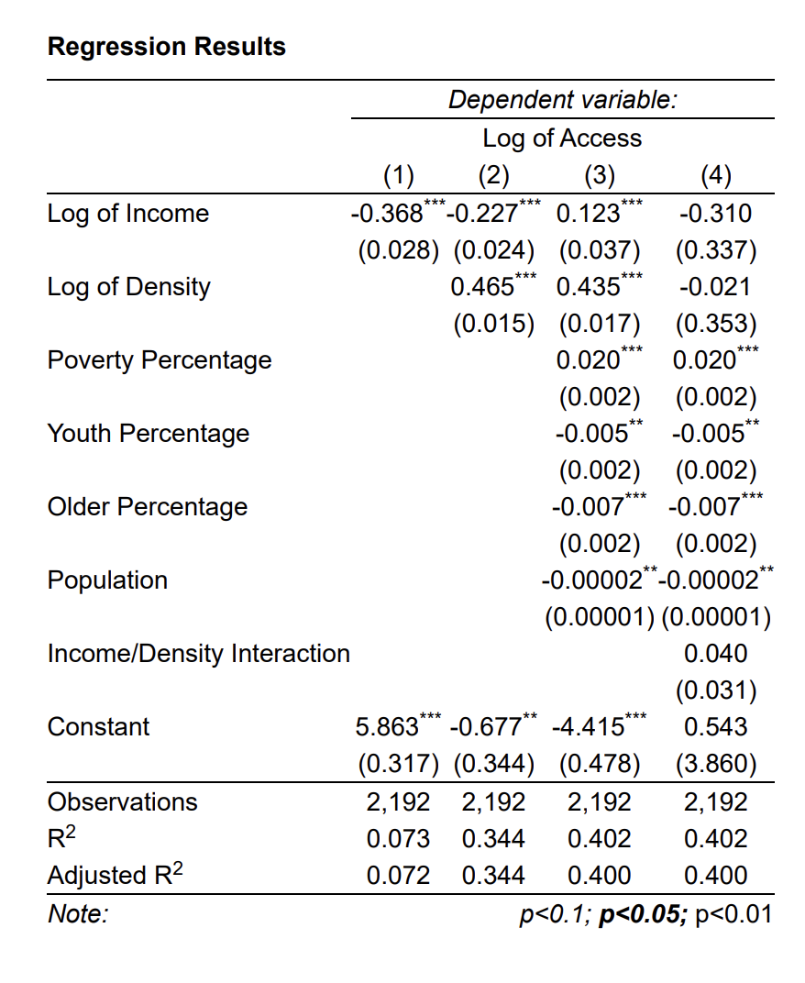
Regression Results
Additional Findings
The Missing Third
Density in Model 3: +0.435***
Poverty in Model 3: +0.020***
Income × Density in Model 4: +0.040 (not significant)

Slide 7
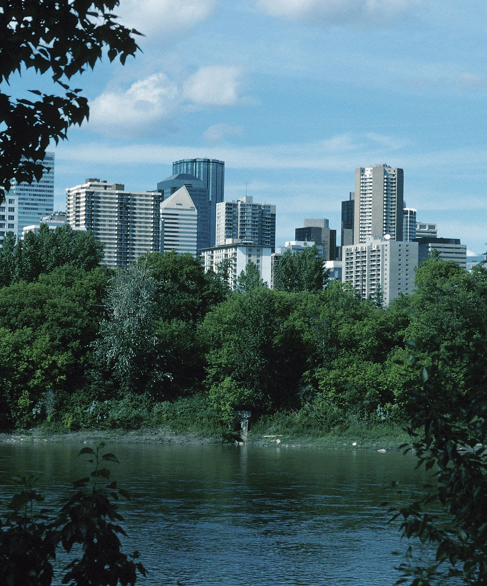
The 15-Minute Social City
The Missing Third
Goal: Improve physical access to third spaces.

Slide 8
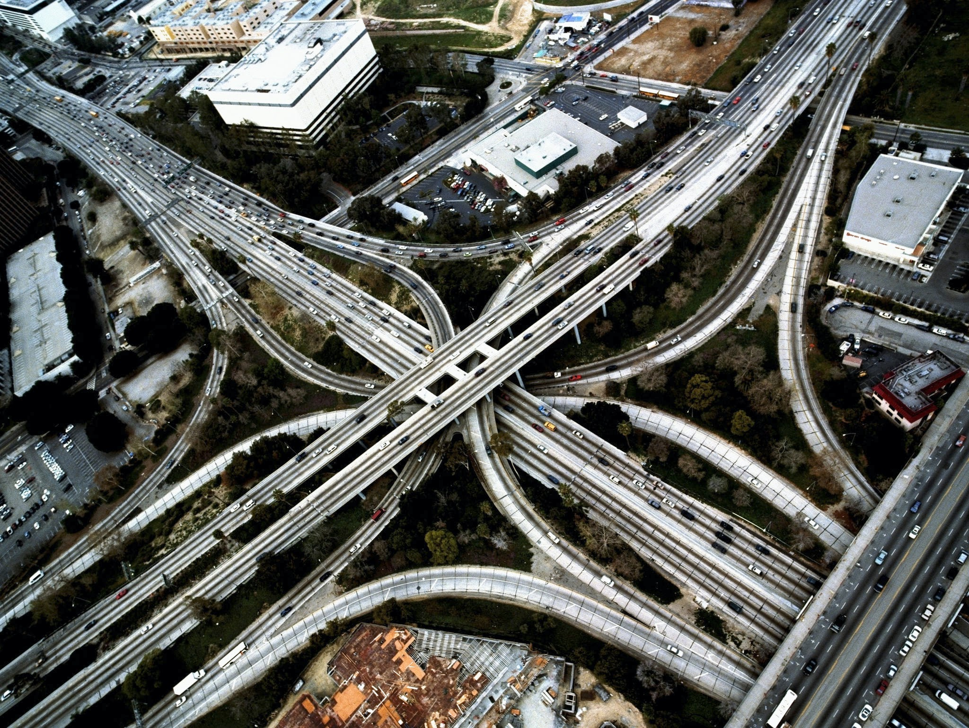
Implementation
Identify 5 underserved neighborhoods.
Fund existing libraries and community facilities.
Expand opening hours and public programming.
Require free public entry.
Pilot Targets
+20% accessible third-space availability
-15% average walking distance
The Missing Third
POLICY 1: THE 15-MINUTE SOCIAL CITY
Budget: $750,000
Expense | Cost
Community grants | $500,000
Mapping and analysis | $50,000
Programming | $100,000
Evaluation | $50,000
Contingency | $50,000

Slide 9
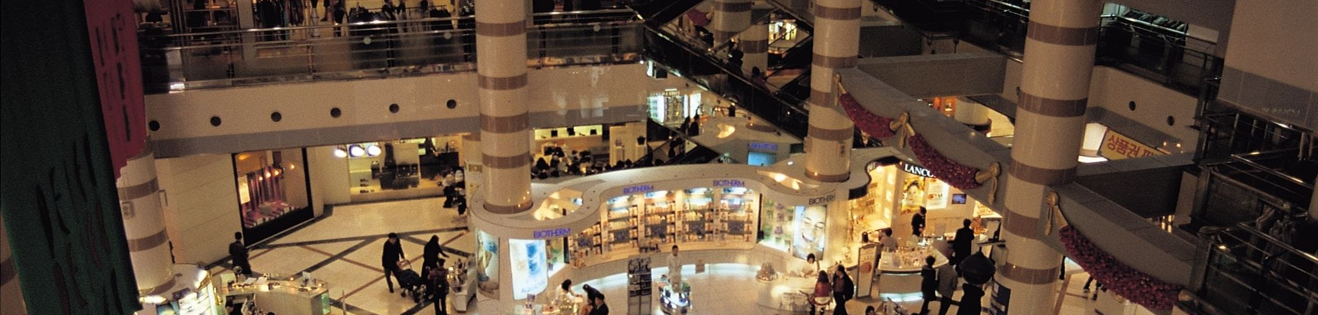
Empty Spaces,
Full Communities
The Missing Third
Goal: Convert vacant storefronts into community spaces.

Slide 10
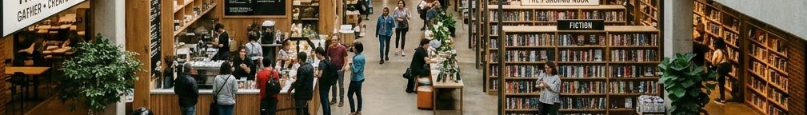
Implementation
Identify 10 suitable vacant storefronts.
Offer rent subsidies to landlords.
Provide basic renovation grants.
Partner with nonprofit organizations
Pilot Targets
10 activated storefronts
70% programming-hour utilization
5 spaces sustained after the pilot
The Missing Third
POLICY 2: EMPTY SPACES, FULL COMMUNITIES
Budget: $600,000
Expense | Cost
Rent subsidies | $240,000
Renovations | $150,000
Programming | $100,000
Administration | $60,000
Evaluation and contingency | $50,000

Slide 11
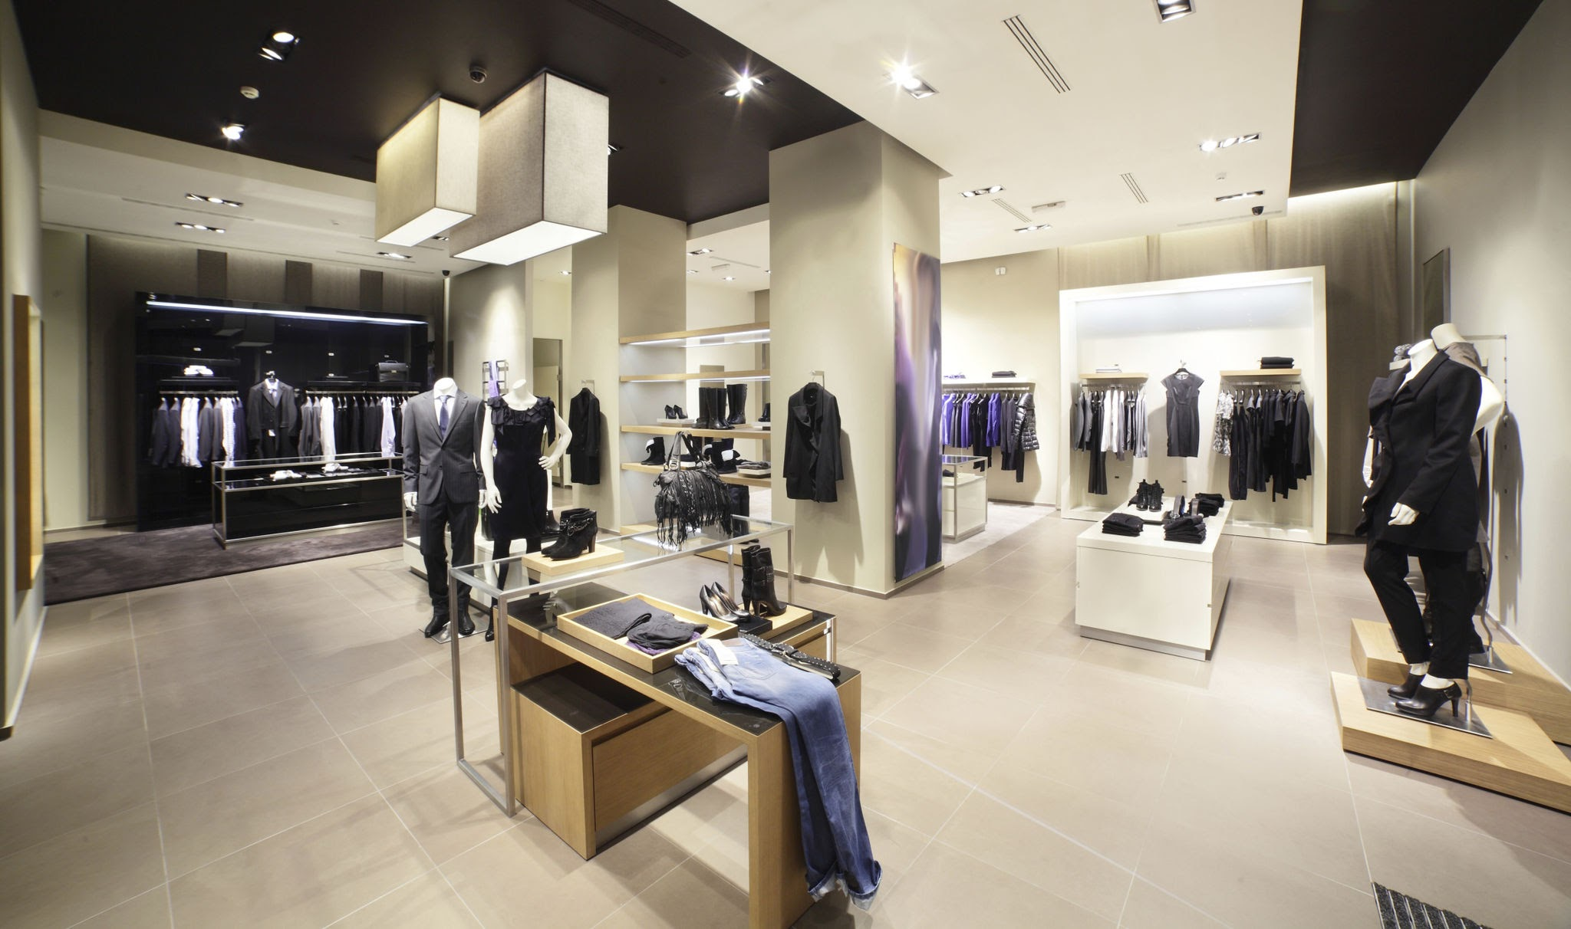
The Price of Belonging
The Missing Third
Goal: Reduce financial barriers to social participation.

Slide 12

Implementation
2,000 eligible residents
$20 monthly Social Access Credits
At least 30 participating venues
Approved low-cost community activities
Pilot Targets
70% credit utilization
+20% social visits relative to a comparison group
The Missing Third
POLICY 3: THE PRICE OF BELONGING
Budget: $600,000
Expense | Cost
Participation credits | $480,000
Administration | $40,000
Outreach | $30,000
Evaluation | $30,000
Contingency | $20,000

Slide 13
Timeline
The Missing Third
Evaluation and sustainability planning
Operations
Launch
Planning and partnerships
1-4
5-6
7-9
10-12

Slide 14
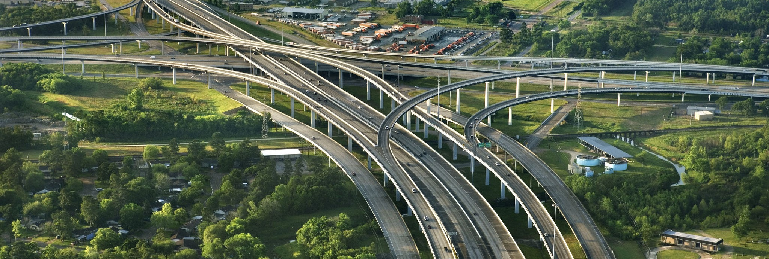

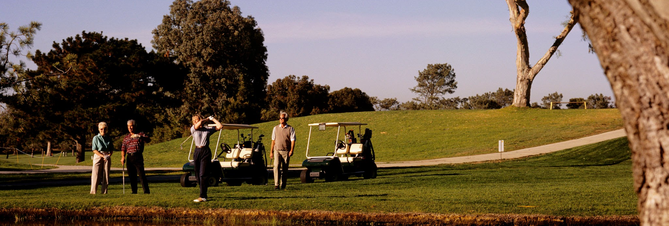
Three Policies. One Goal.
How We Measure Success:
Walking accessibility and community visits
Storefront activation and utilization
Additional social participation
Cost per additional visit
The Missing Third
THE 15-MINUTE SOCIAL CITY
ACCESSIBILITY
EMPTY SPACES, FULL COMMUNITIES
AVAILABILITY
THE PRICE OF BELONGING
AFFORDABILITY

Slide 15

Final Message
The Missing Third
Our main goal is to make an efficient public investment focused on the common New York resident.

Slide 16

Oldenburg, R. (1989). The great good place. Paragon House.
Klinenberg, E. (2018). Palaces for the people: How social infrastructure can help fight inequality, polarization, and the decline of civic life. Crown.
Chetty, R., Jackson, M. O., Kuchler, T., et al. (2022). Social capital II: Determinants of economic connectedness. Nature, 608, 122–134. https://www.nature.com/articles/s41586-022-04997-3
Moreno, C., Allam, Z., Chabaud, D., Gall, C., & Pratlong, F. (2021). Introducing the “15-minute city”: Sustainability, resilience and place identity in future post-pandemic cities. Smart Cities, 4(1), 93–111. https://www.mdpi.com/2624-6511/4/1/6
New York City Office of the Comptroller. (2026). Who's minding the storefronts? An analysis of storefront vacancies in New York City. https://comptroller.nyc.gov/reports/whos-minding-the-storefronts/

Slide 17
Thank you

Slide 18
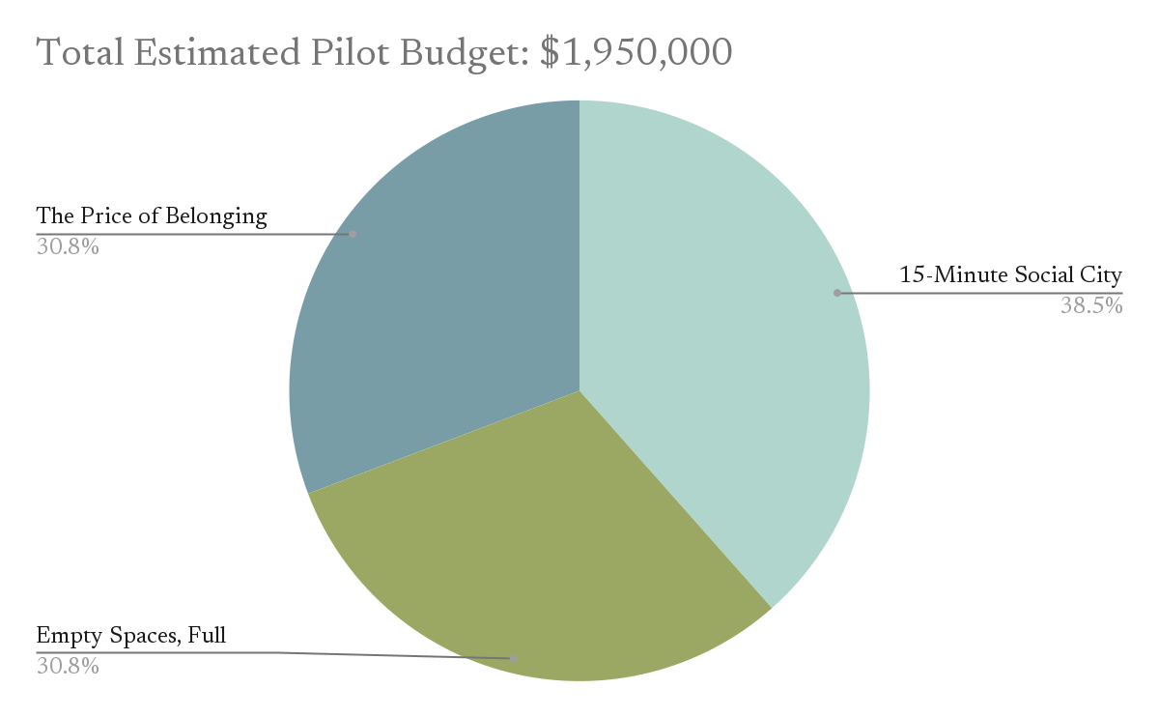
Company Name
COST STRUCTURE
Proposed Funding
Municipal government: $915,000
Foundations: $525,000
Corporate sponsors: $390,000
Landlord contributions: $120,000 (potentially in-kind)

